Slide 1
March of the Penguin
31 years Linux Snapshot
Present By: Yusuf Hadiwinata Sutandar
Notes:
<nomor>
https://www.linuxjournal.com/article/9065
https://arstechnica.com/information-technology/2011/08/march-of-the-penguin-ars-looks-back-at-20-years-of-linux/

Slide 2


Hello & Welcome
Yusuf Hadiwinata Sutandar​
Linux Geek, Opensource Enthusiast, Security Hobbies​
RHCT, RHCSAv5-v7, RHCEv5-v7, RHCVA, RHCI, RHCX, RHCSA-RHOS, RHCJA, CEI, CEH, CHFI, CND, EDRP, CCNA, MCTCNA, Security+, Network+, VCA, vExpert 2017-2018​
VP Operation & Services – PT Biznet Gio Nusantara
The movie documentary depicts the yearly journey of the emperor penguins of Antarctica.
Notes:
<nomor>

Slide 3

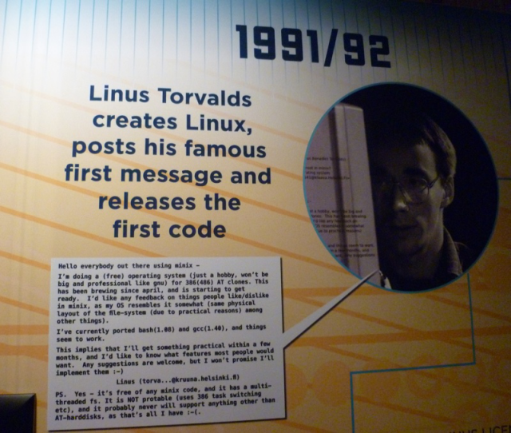
1991: A Brief History
Linus Torvalds announced Linux
Linux began in 1991 as a personal project by Finnish student Linus Torvalds: to create a new free operating system kernel. The resulting Linux kernel has been marked by constant growth throughout its history.
Notes:
<nomor>

Slide 4

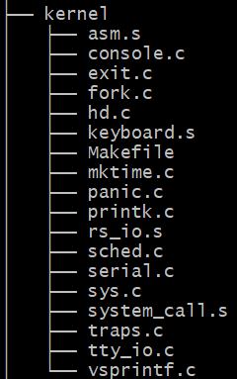
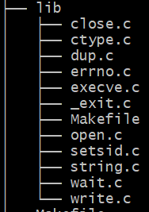
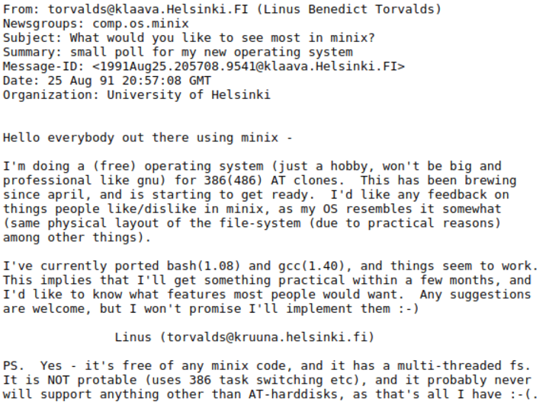
A Brief History
Notes:
<nomor>
https://ubuntu.com/blog/happy-birthday-30-years-of-linux

Slide 5


1992: Became Opensource
Linux was not always Open Source. The first few licenses of Linux forbid commercial redistribution.
It was with version 0.12 in February’92 that Linux Kernel was released under GPL. As per Linus Torvalds, open sourcing Linux was the best thing he ever did.
Notes:
<nomor>
https://ubuntu.com/blog/happy-birthday-30-years-of-linux

Slide 6

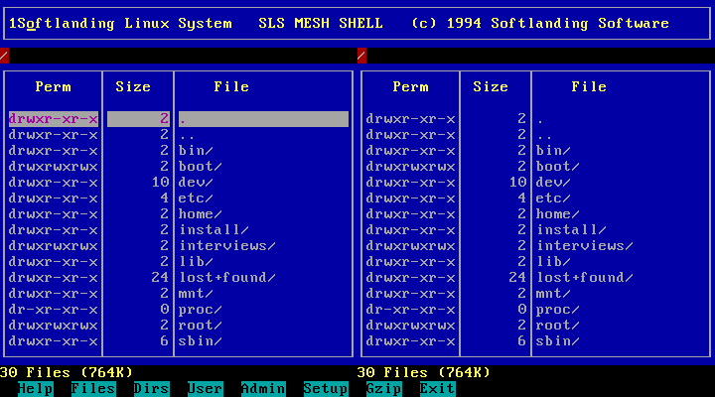
1992: Softlanding Linux
System (SLS)
SLS was the first release to offer a comprehensive Linux distribution containing more than the Linux kernel, GNU, and other basic utilities, including an implementation of the X Window System
It was soon superseded by Slackware
Notes:
<nomor>
https://ubuntu.com/blog/happy-birthday-30-years-of-linux

Slide 7

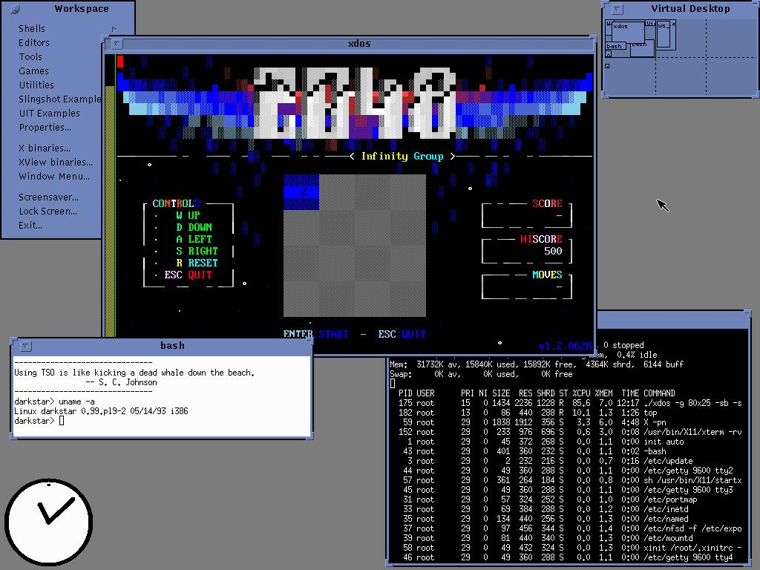
1993: Slackware Release
Slackware Linux version 1.0 was released on 17th July 1993.
Slackware Linux is the oldest Linux which is still in development.
Notes:
<nomor>
https://ubuntu.com/blog/happy-birthday-30-years-of-linux

Slide 8

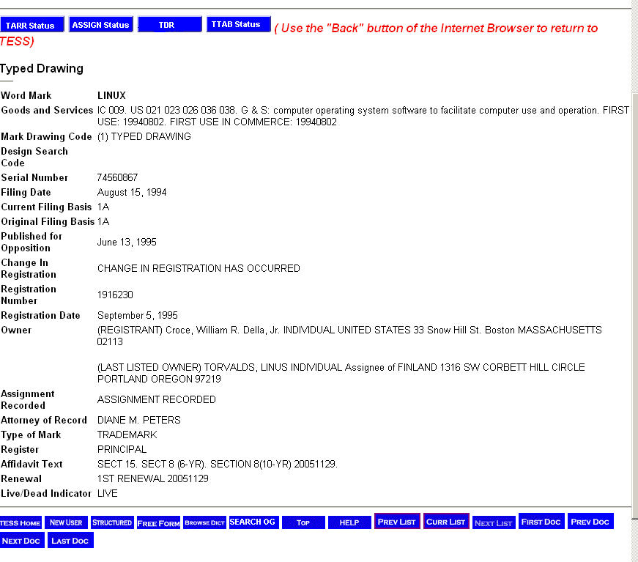
1994: Someone registered Linux trademark
Linux trademark was registered in 1994 by a William R. Della Croce, Jr. That guy then went on to demand royalties from Linux distributors. Linus Torvalds won the court battle three years later.
Notes:
<nomor>
https://ubuntu.com/blog/happy-birthday-30-years-of-linux

Slide 9

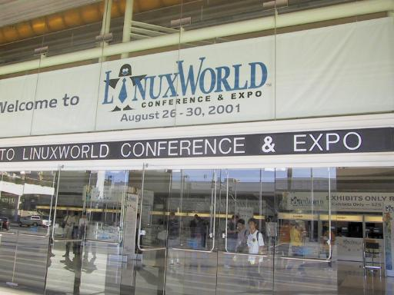
1995: First Linux Expo
First Linux specific tradeshow and conference series was launched by people at North Carolina State University.
This became one of the most attended annual Linux show for next several years.
Notes:
<nomor>
https://ubuntu.com/blog/happy-birthday-30-years-of-linux

Slide 10


1995: Linux have mascot
Tux is the name of the penguin character that was created to officially become the Linux kernel brand.
“Though Linus Torvalds was once bitten by a penguin, he still recommended a penguin as the mascot of Linux. Tux was created by Larry Ewing in 1996”
Notes:
<nomor>
https://ubuntu.com/blog/happy-birthday-30-years-of-linux
https://www.linuxadictos.com/en/tux.html
https://logos-world.net/linux-logo/

Slide 11


1996 - Pivotal Moments
The Cathedral model, in which source code is available with each software release, but code developed between releases is restricted to an exclusive group of software developers. GNU Emacs and GCC were presented as examples.
The Bazaar model, in which the code is developed over the Internet in view of the public. Raymond credits Linus Torvalds, leader of the Linux kernel project, as the inventor of this process. Raymond also provides anecdotal accounts of his own implementation of this model for the Fetchmail project.
The Cathedral and the Bazaar
Notes:
<nomor>
https://www.google.co.id/books/edition/The_Cathedral_and_the_Bazaar/_CNnEAAAQBAJ?hl=en&gbpv=1&printsec=frontcover

Slide 12

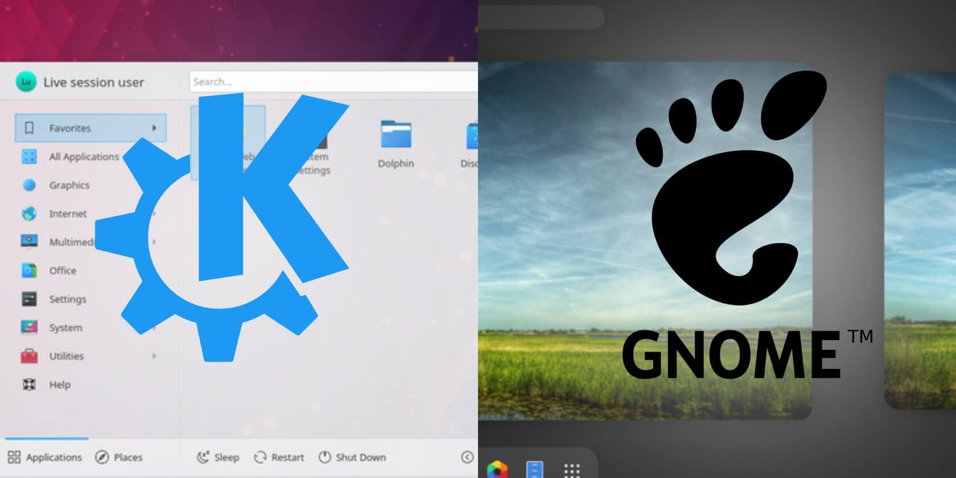
1997-1998 - Desktop era
1998: KDE 1.0 released
Another crucial part of desktop Linux, KDE project saw its first stable release in 1998. Like GNOME, KDE too has been a crucial part of desktop Linux.
1997: GNOME Project is born
GNOME is one of the most successful open source projects. It has been crucial to the spread of desktop Linux. It has given us a number of programs that we use today on desktop Linux.
Notes:
<nomor>
https://www.google.co.id/books/edition/The_Cathedral_and_the_Bazaar/_CNnEAAAQBAJ?hl=en&gbpv=1&printsec=frontcover

Slide 13

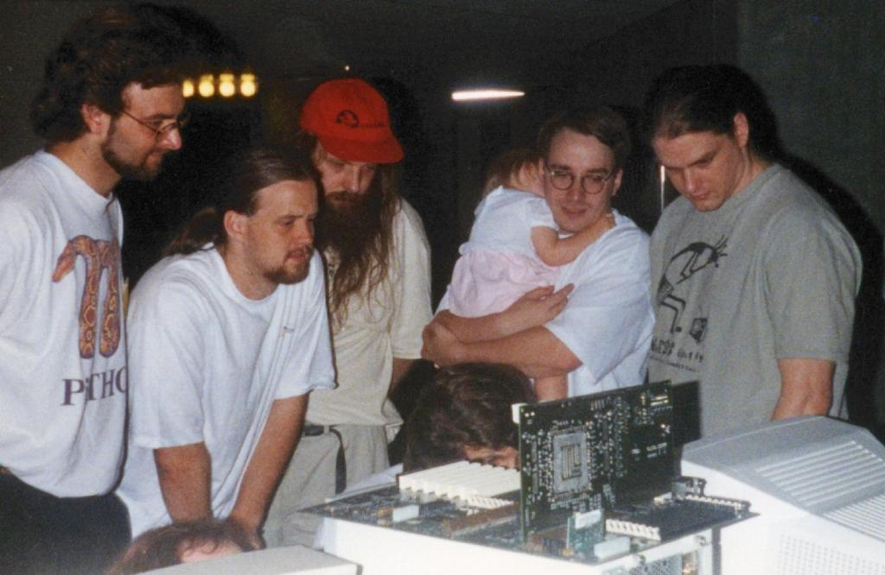
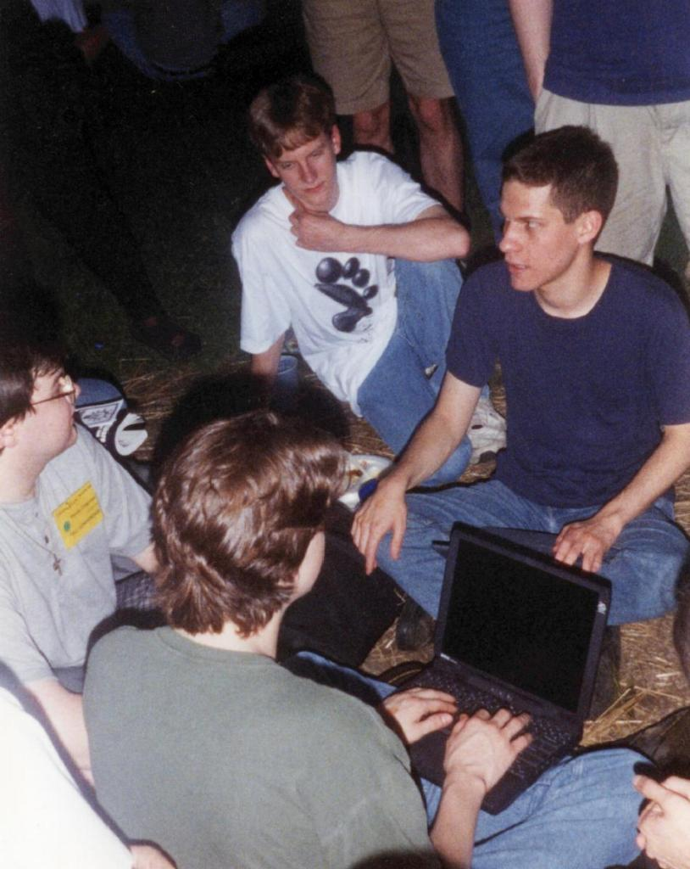
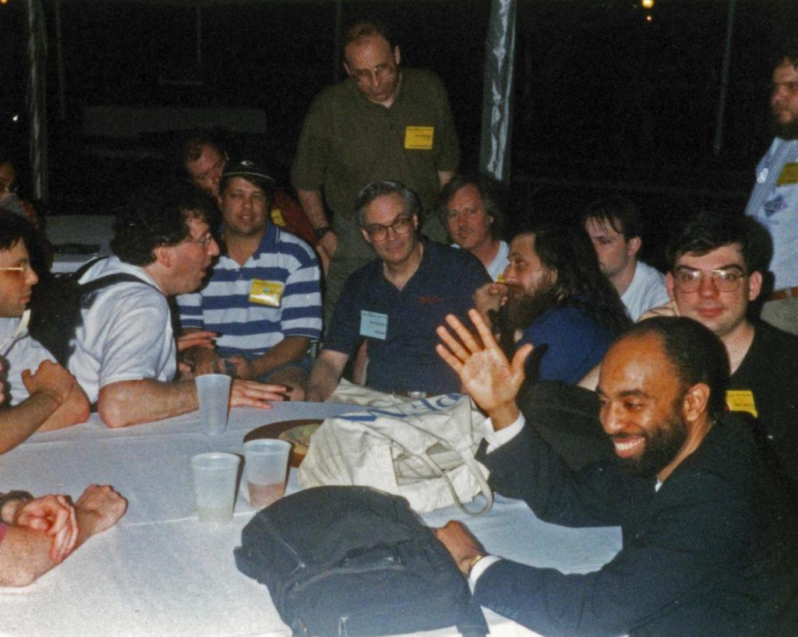
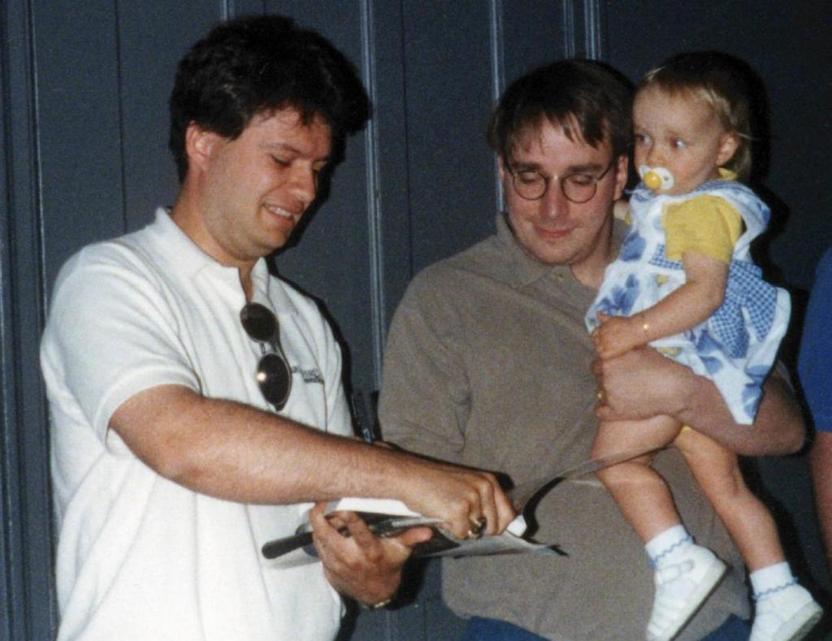
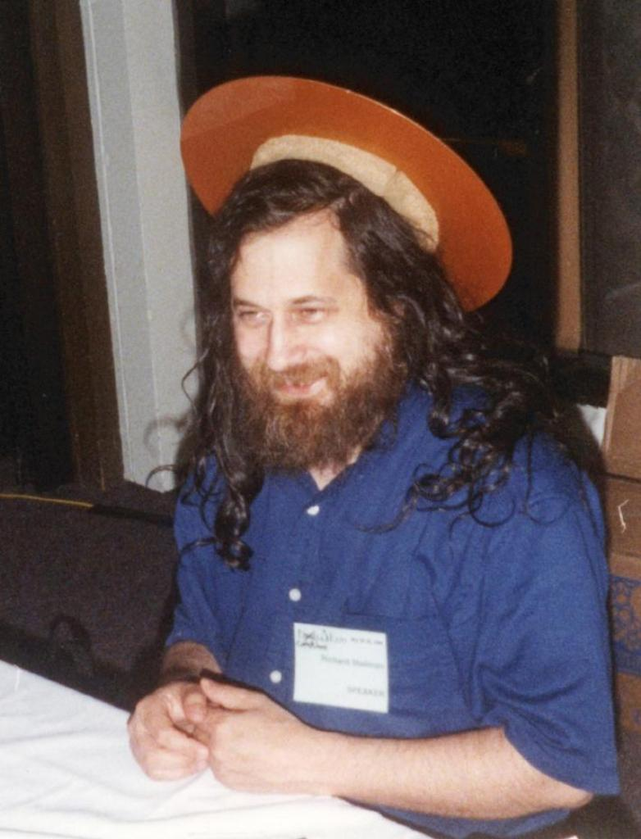
1998: Linux Expo
Hardware Hacking
Gnome folks
Bruce perens vs RMS
Linus Sign
St of Emacs
Notes:
<nomor>
https://stallman.org/saint.html
http://techrights.org/2009/12/20/bruce-perens-on-gnome-gnu/

Slide 14

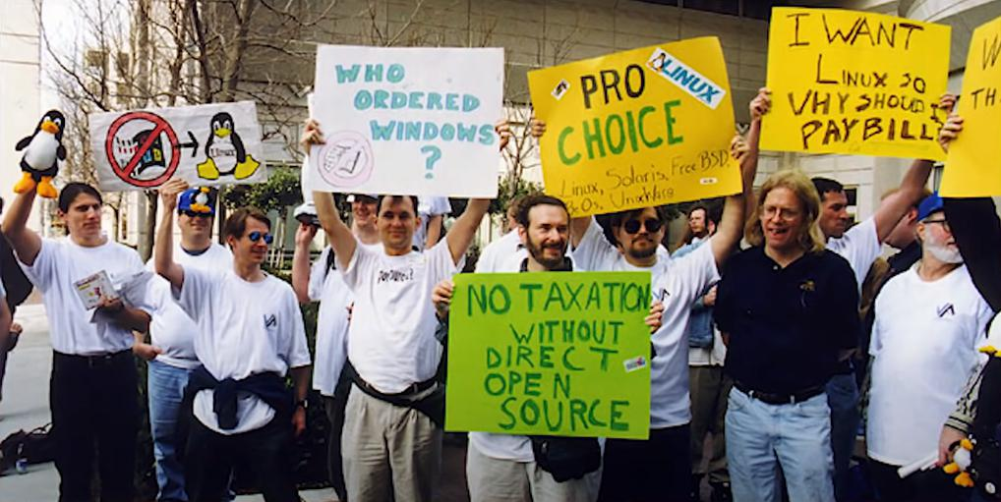
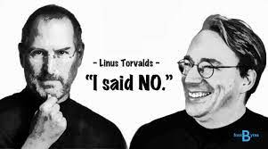
1999-2000
1999: Linux users observed Windows Refund Day
2000: Steve Jobs made an offer that Linus refused
As most of the computer system came bundled with Microsoft Windows, Linux users worldwide observed Windows Refund Day on February 15th, 1999. They went to Microsoft’s offices to return their unused licenses of Windows.
Steve Jobs offered Linus Torvalds to come work for Mac OS to make “Unix for the biggest user base”. Not only this, Jobs even tried to persuade Linus to drop working on Linux.
Notes:
<nomor>
https://stallman.org/saint.html
http://techrights.org/2009/12/20/bruce-perens-on-gnome-gnu/

Slide 15
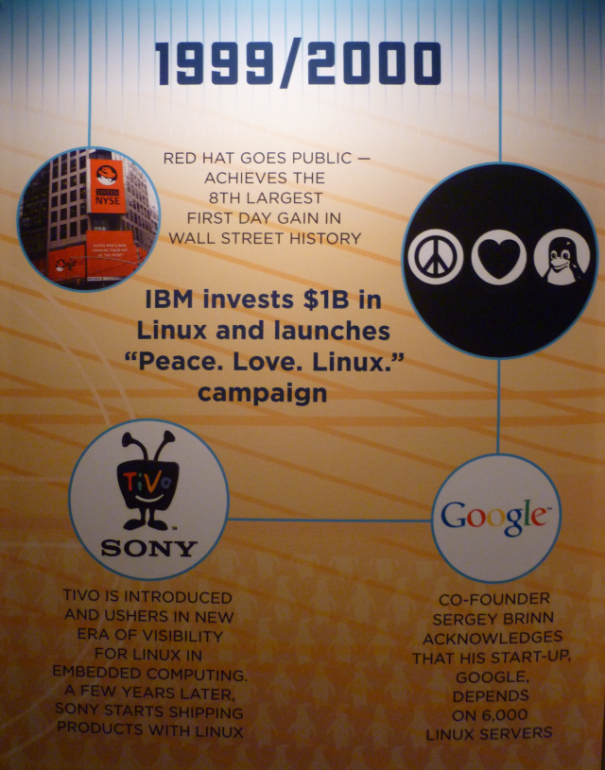
Linux kernel under the GNU GPL License in 1992
Same year, Torvalds published version 0.99 with the GNU GPL license
Around 2000, Linus Torvalds announced Linux kernel comes under the GPLv2 license
After years of drafts and discussions, in 2007, Torvalds released GPLv3
Notes:
<nomor>

Slide 16
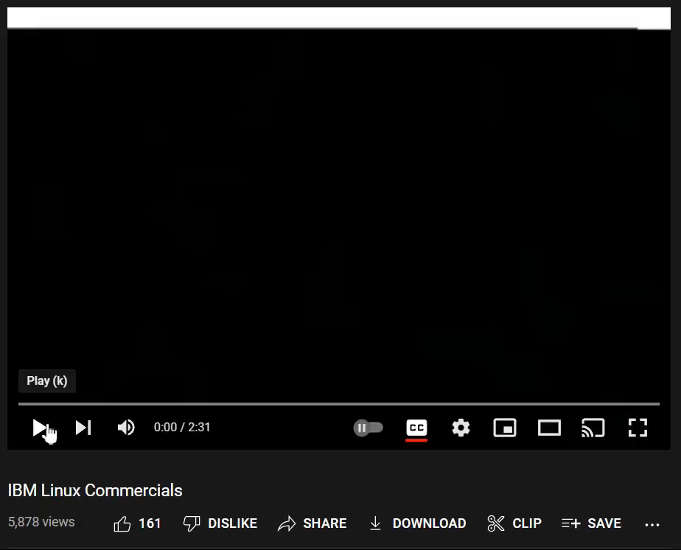
The IBM Linux
commercial from 2000 - 2003.
Notes:
<nomor>

Slide 17

Fast Forward…
Notes:
<nomor>

Slide 18

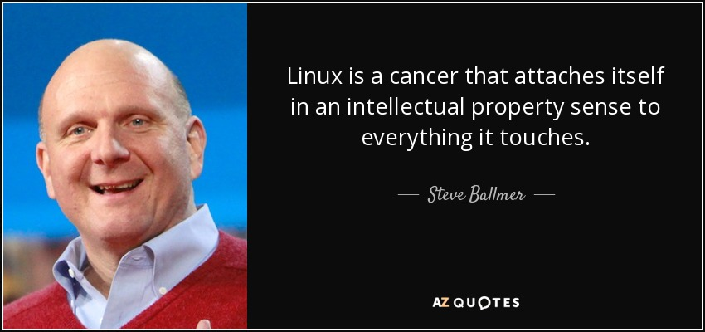
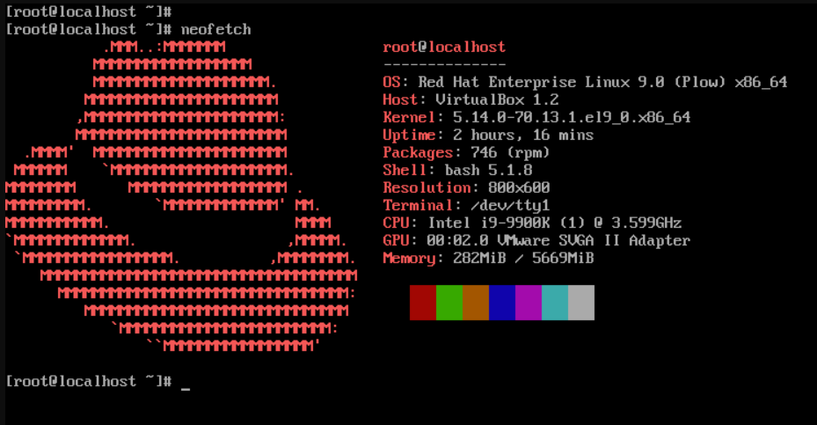
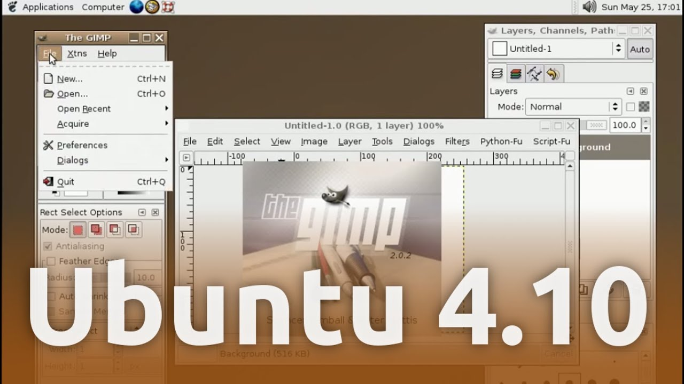
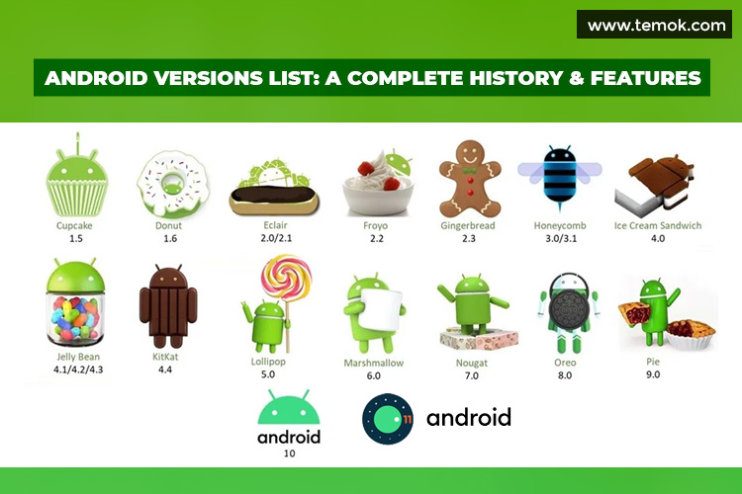
2001-2010
2001: MS said Linux is Cancer
2002: RHEL Release
2003: Attempt to Backdooring Linux, Suse Brand registred
2004: Ubuntu 4.10 released
2005: Linus Torvalds created Git, OpenSuse Release
2007: Linux powered netbook arrived
2008: Android version 1.0 released
2009: Google announced Chrome OS
2010: RH became 1st bill $ open source company
Notes:
<nomor>
https://itsfoss.com/25-years-linux/

Slide 19


Linux Adoption in Indonesia
March of the Penguins
2005 ‧ Documentary/Nature documentary
Notes:
<nomor>

Slide 20



Linux adoption in Indonesia
1992 - SoftLanding System Distro Entering Indonesia by Bung Yono, using Kernel 0.9x (alpha testing)
1994 - Slackware entering Indonesia using Kernel 1.0 run on top off i386 and i486 (Lab UI)
1995 - Indonesian ISP adopt GNU/Linux, Indonesian Government also adopt Linux (BPPT), Slackware community born in University (UI)
1996-7 - More adoption Linux on ISP
Notes:
<nomor>
https://www.linkedin.com/in/paulus-suryono-adisoemarta-880556114/details/experience/
https://dedenthea.wordpress.com/2007/11/13/sejarah-linux-di-indoensia/

Slide 21





1998 - KPLI Jakarta Born
a forum for observers of the world of information technology, especially those living in Jakarta and its surroundings, with the desire to actively participate in this world by supporting Open Source activities.
Purpose:
Developing Linux as an alternative educational tool.
Developing Linux as a solution that is cheap, legal, and useful for the business world.
Participate in assisting efforts in changing the way Indonesian people view technology, from being a technology user to being a technology creator.
Notes:
<nomor>
https://www.elektroindonesia.com/elektro/li0899b.html

Slide 22













2004 - Linux Community
Development era of Local Linux Distro
GrombyangOS – For Education
TeaLinuxOS – For Programmers
Desa OS – For Village Development
Garuda OS – Based on PCLinuxOS
Xenta OS – Focus on compatibility
Muslims OS – Remaster from ubuntu
Codernate - Focus on simplicity and security tools
IbisLinux - based on LFS
Grombyang OS
Dracos Linux - Focus on Security
Zencafe - designed specifically for public Internet cafe
Trustix Merdeka – based on Trustix Secure Linux
2004 - BlankOn Linux - Debian-based Linux focus for end users, Develop by BlankOn team with support from YPLI
2006 - IGOS Nusantara (IGN) – Develop by community together with LIPI
2007 - Nusantara Linux – Develop by YPLI and Kemenristek
https://lms.onnocenter.or.id/wiki/index.php/OS:_Linux_Buatan_Indonesia
Notes:
<nomor>
https://hendro-wibiksono.web.id/2021/09/17/macam-macam-distro-linux-karya-anak-bangsa-indonesia/

Slide 23
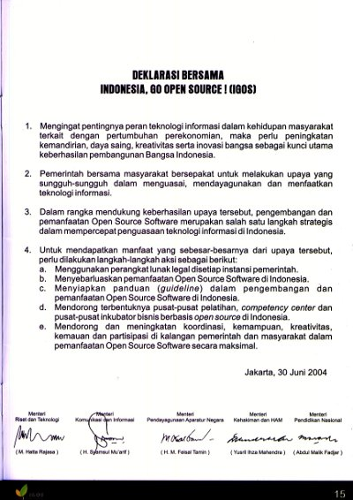
2004 - IGOS
Indonesia Go Open Source Targets:
Provide more alternative software that can be used by the community legally and affordable, so that the number of computer users increases.
Improvement of research and development capabilities of national information technology in the field of software.
Creating information technology development competition to be able to compete in the global arena
Menteri Riset dan Teknologi M. Hatta Rajasa
Menteri Komunikasi dan Informasi H. Syamsul Mu'arif
Menteri Pendayagunaan Aparatur Negara H. M. Feisal Tamin
Menteri Kehakiman dan HAM Yusril Ihza Mahendra
Menteri Pendidikan Nasional Abdul Malik Fadjar
https://id.wikipedia.org/wiki/Indonesia,_Go_Open_Source
Notes:
<nomor>

Slide 24





2004 - OpenSuse.id
The openSUSE Indonesia community is a non-profit community that was established to support the use, promotion and provide assistance for users of openSUSE Linux distributions throughout Indonesia.
Notes:
<nomor>

Slide 25
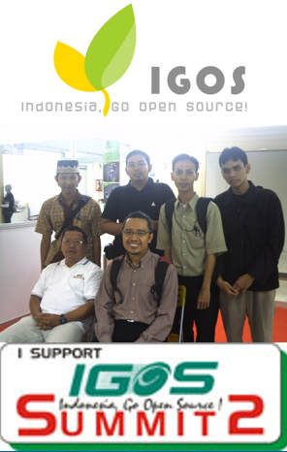
2008 - IGOS Summit
The IGOS logo is depicted as a leaf bud that continues to grow and develop so that it represents the spirit to continue to grow and promote the use of Free/Open Source Software.
Desian Logo IGOS competition
Blog Competition
Talkshow
Appreciation for OSS Warrior, Leaders and Institution
Emagazine Competition
Notes:
<nomor>
http://lipi.go.id/berita/single/Inilah-Para-Pendeka-Open-Source-di-IGOS-Summit-2/2018

Slide 26








2008 - 1 months later: AOSI
1 month at the 1st declaration on IGOS Summit2, AOSI was born. AOSI (Asosiasi Opensource Indonesia) is a legal entity association that brings together organizations of lovers, activists, developers, users, educators, business people and all national-scale Open Source supporters who work together, working hand in hand to build synergies to achieve mutual success.
Vision Mission:
Provide FOSS Services
Open Source Software Incubator
Notes:
<nomor>

Slide 27
2008 - OSS benefit on Gov
Key Success:
Political environment
Leadership
Planning
Stakeholders
Transparency
Surat Edaran Menkominfo on 2005 regarding the Use and Utilization of Legal Software in Government Agencies
Surat Edaran MenPan No. SE/01/M.PAN/3/2009 date: 30 Maret 2009 about "Use and Utilization of Legal Software and Open Source Software (OSS)", and the preparation of each government agency in responding to the deadlines of the Circular Letter. The deadline is on 31 Dec 2011
Benefits:
e-government Adoption
Digital Transformation
Efficiency Budget
Compliance
https://lms.onnocenter.or.id/wiki/index.php/30_Maret_2009_-_Surat_Edaran_MENPAN_Pemanfaatan_Open_Source
Notes:
<nomor>
Surat Edaran Menkominfo pada tahun 2005 tentang Pemakaian dan Pemanfaatan Penggunaan Piranti Lunak Legal di Lingkungan Instansi Pemerintah
file:///C:/Users/yusuf/Downloads/2568-Article%20Text-4508-1-10-20130524.pdf
Surat Edaran Menpan pada tahun 2009, yang menginstruksikan agar instansi Pemerintah Pusat dan Pemerintah Daerah melalui pimpinannya untuk melakukan pengecekan penggunaan perangkat lunak di lingkungan dan menghapus semua perangkat lunak tidak legal, dan selanjutnya menggunakan Free & Open Source Software (FOSS)

Slide 28




2009 - 11: Migration Time
Notes:
<nomor>
Surat Edaran Menkominfo pada tahun 2005 tentang Pemakaian dan Pemanfaatan Penggunaan Piranti Lunak Legal di Lingkungan Instansi Pemerintah
file:///C:/Users/yusuf/Downloads/2568-Article%20Text-4508-1-10-20130524.pdf
Surat Edaran Menpan pada tahun 2009, yang menginstruksikan agar instansi Pemerintah Pusat dan Pemerintah Daerah melalui pimpinannya untuk melakukan pengecekan penggunaan perangkat lunak di lingkungan dan menghapus semua perangkat lunak tidak legal, dan selanjutnya menggunakan Free & Open Source Software (FOSS)

Slide 29




2011 - Opensource Award
Indonesia Open Source Awards - Category Ministry/LPNK
IOSA 2010 winners
1st : Kementrian Pertahanan
2nd : Sekertariat Negara
3rd : Badang pengawas tenaga nuklir
IOSA 2011 winners
1st : Badan Pengawas Tenaga Nuklir (BAPETEN)
2nd : Kementrian Kehutanan
3rd : Kementrian Pemuda dan Olahraga
IOSA 2012 winners
1st : Badan Pelaksana Kegiatan Usaha Hulu Minyak dan Gas Bumi (BPMIGAS)
2nd : Badan Pengawas Tenaga Nuklir (BAPETEN)
3rd : Lembaga Pertahanan Nasional
IOSA 2013 winners
1st : Badan Pengawas Tenaga Nuklir (BAPETEN)
2nd : Badan Intelijen Negara (BIN)
3rd : Kementrian Kehutanan
Notes:
<nomor>
https://www.kominfo.go.id/content/detail/1770/open-source-hemat-anggaran-pemerintah-puluhan-miliar-rupiah/0/sorotan_media
https://www.kominfo.go.id/content/detail/1769/kemenkominfo-gelar-indonesia-open-source-award/0/sorotan_media
https://milisdad.wordpress.com/category/iosa/

Slide 30
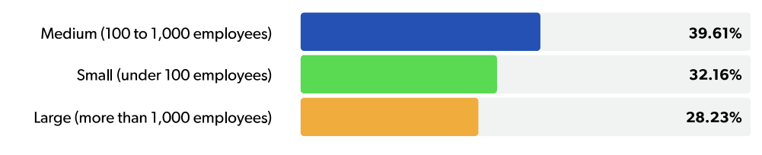
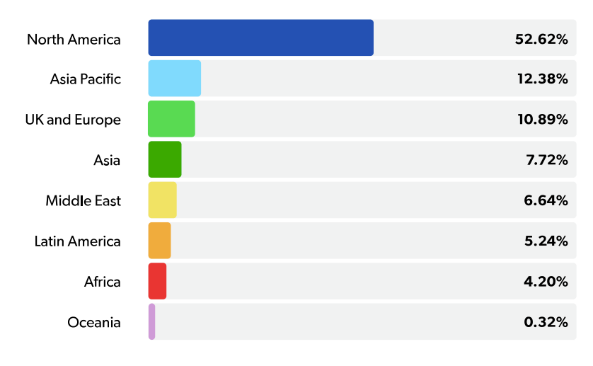
2011 - Linux Adoption
Everyone in every company size is using open source software
Asia Pacific in 2nd place of Opensource Adoption
Notes:
<nomor>

Slide 31
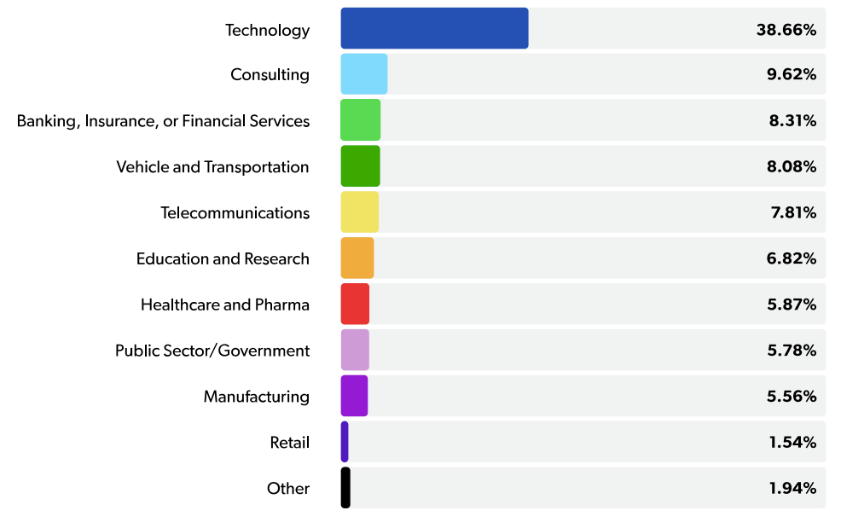
2022 - Linux Adoption
Top Concerns in Using Open Source Software
Lack of internal skills to test, use, integrate, and support
Restrictions in some open source licenses
There’s no real-time support
Notes:
<nomor>

Slide 32
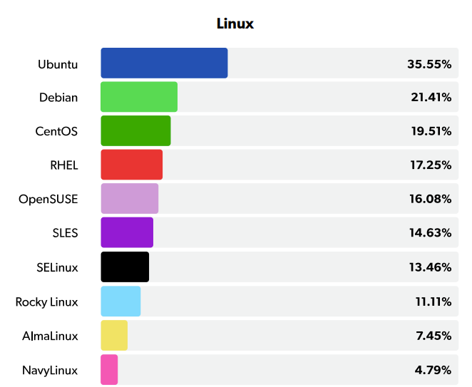
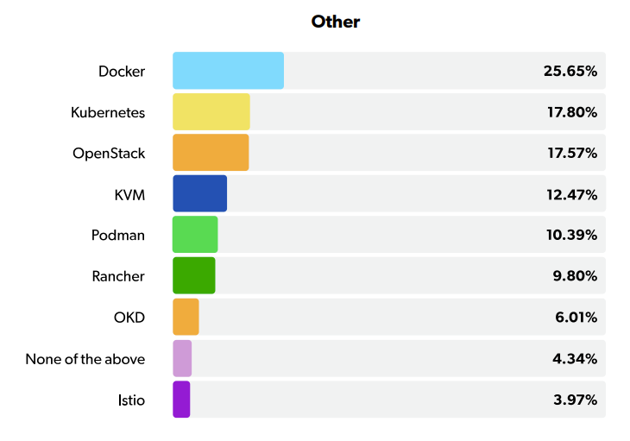
2022 - Linux Adoption
Top Open Source Infrastructure Technologies
Notes:
<nomor>

Slide 33
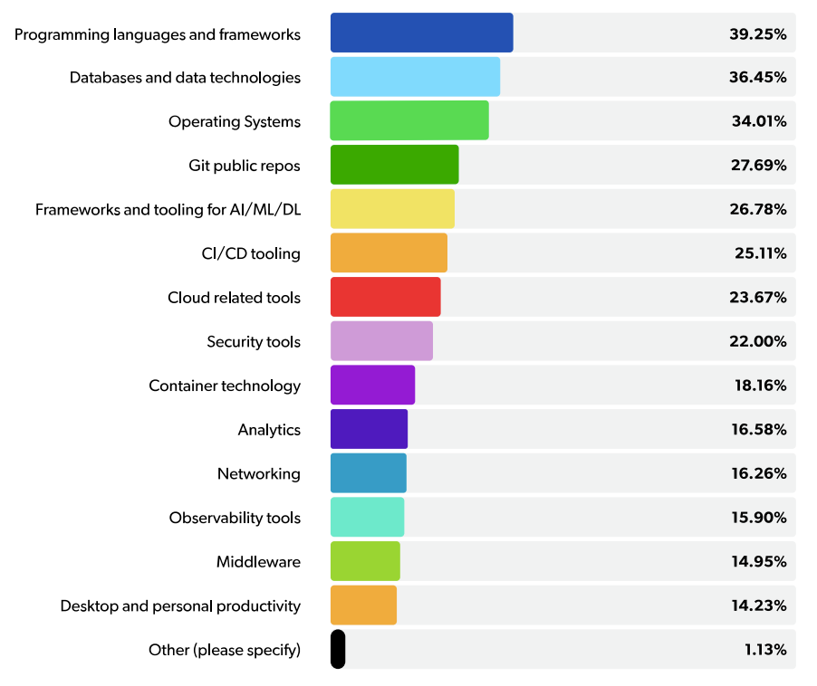
2022 - Linux Adoption
Type of Open Source Software Is Used in Organization
Notes:
<nomor>

Slide 34
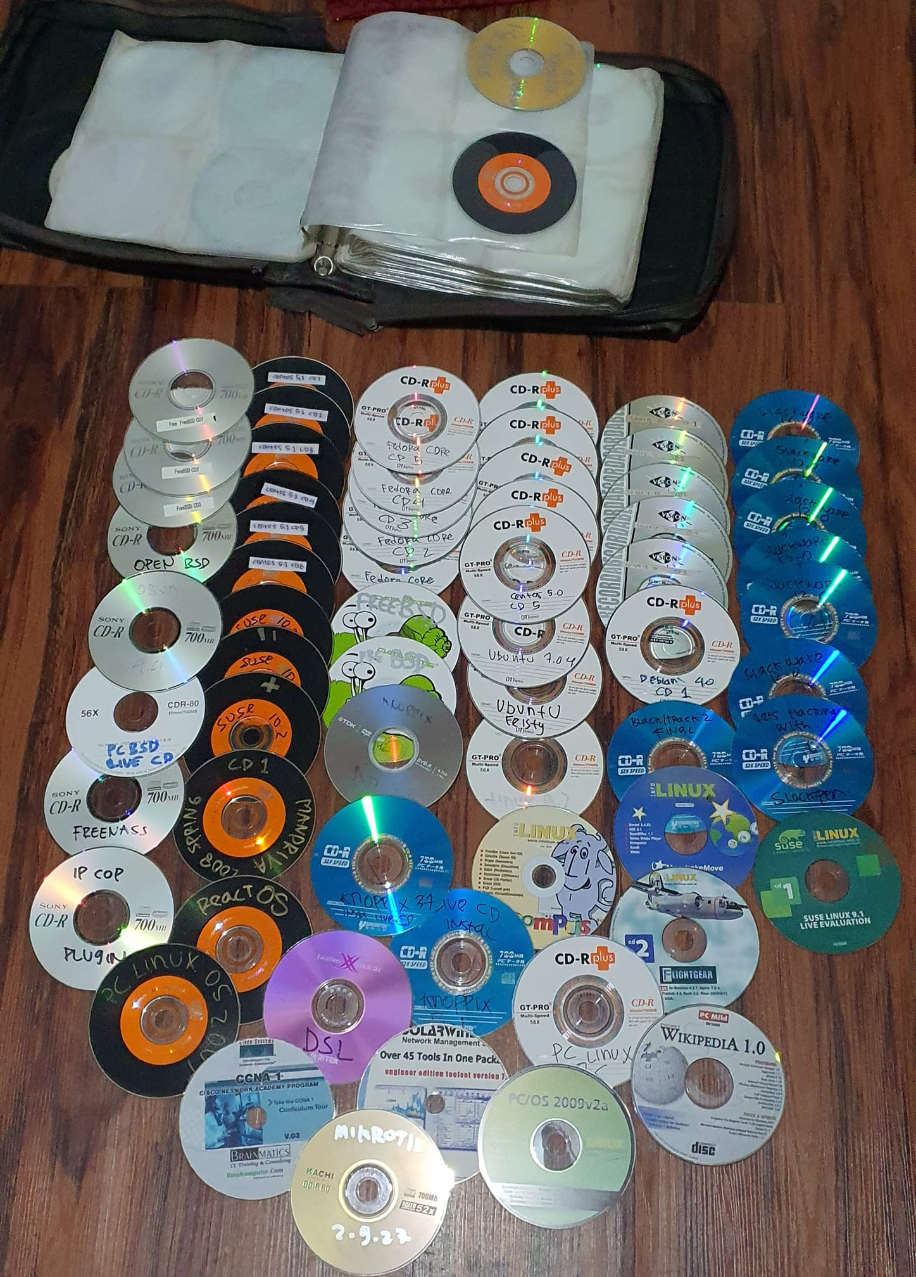
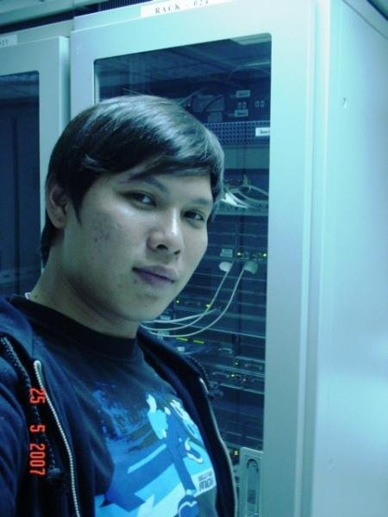
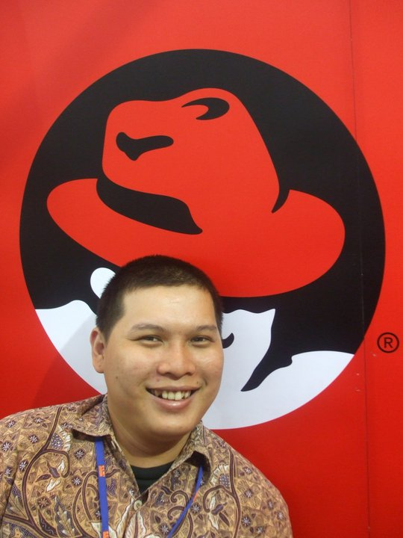
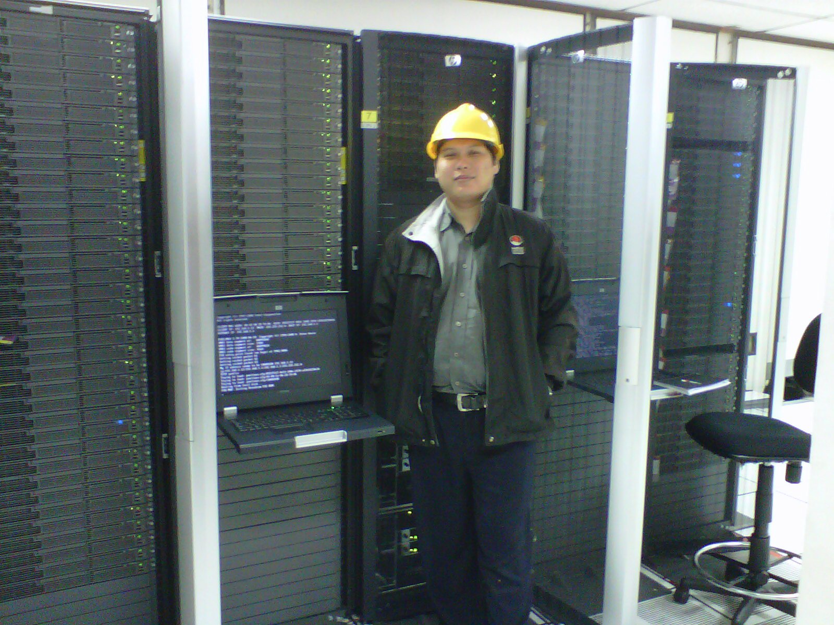
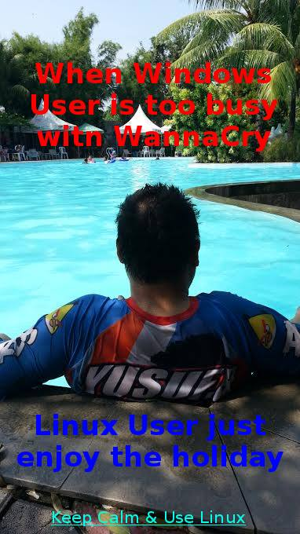
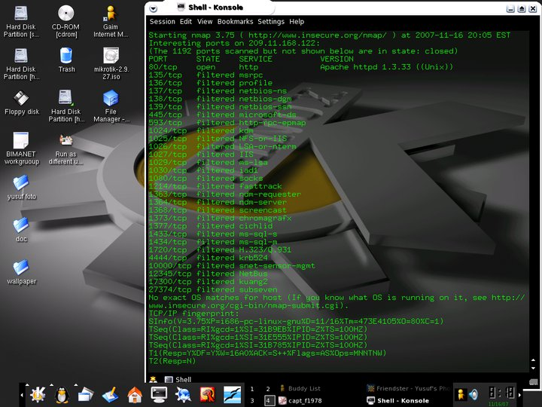
My moment with Linux
Linux CD
2007
2010
2011
2017
2004 Knoppix 3.4
Notes:
<nomor>

Slide 35



Biznet Gio Commitments
Notes:
<nomor>

Slide 36
About Biznet Gio Cloud
Compute:
NEO Virtual Compute
Mesin virtual instan dengan OpenStack
NEO Metal
Server Baremetal dengan Intel atau AMD
GIO Public
Data Center virtual berbasis VMWare
GIO Private
Private Cloud berbasis VMWare vCloud
NEO Lite
VPS cepat dengan SSD Storage
Storage:
NEO Object Storage
Storage yang kompatibel dengan Amazon S3
GIO Backup
Perlindungan data Cloud tanpa henti
NEO Elastic Storage
IOPS UltraFast
AI & ML:
NEO Face Recognition
API Pengenalan Wajah yang Andal
Web:
NEO Web Hosting
Web hosting andal dengan dukungan 24 jam
NEO Web Space
Buat website tanpa perlu jago coding
NEO Dedicated Hosting
Web hosting andal dan dedikatif
NEO WordPress
WordPress Hosting instan
Domain:
NEO Domain
Daftar lengkap berbagai ekstensi domain
NEO DNS
DNS Anycast untuk akses cepat website
Notes:
<nomor>

Slide 37
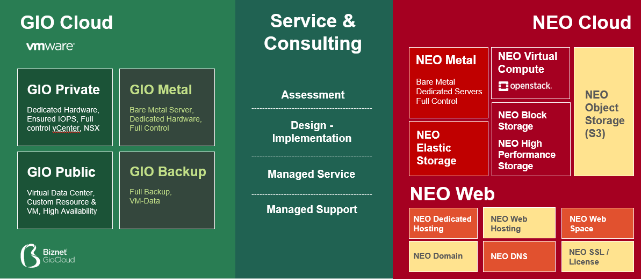
Biznet Gio Products
NEO
Lite
NEO
WordPress
Enterprise
Self Service
Notes:
<nomor>

Slide 38


Biznet Gio Products
GIO Cloud
Service &
Consulting
NEO Cloud
NEO Metal
NEO Virtual
Compute
NEO High Performance Storage
GIO Private
GIO Metal
Assessment
Bare Metal Dedicated Servers
Full Control
Dedicated Hardware, Ensured IOPS, Full control vCenter, NSX
Bare Metal Server, Dedicated Hardware, Full Control
NEO Object Storage (S3)
Design - Implementation
NEO Elastic Storage
NEO
Lite
NEO Block Storage
GIO Public
GIO Backup
Virtual Data Center, Custom Resource & VM, High Availability
Full Backup,
VM-Data
Managed Service
NEO Web
NEO Dedicated Hosting
NEO Web Hosting
NEO Web Space
NEO WordPress
Managed Support
NEO Domain
NEO DNS
NEO SSL / License
Face Recognition
Enterprise
Self Service

Slide 39



Slide 40




Biznet Gio Valuable Deals
24 Hours
UPTIME
FREE
Managed
Support
SLA
Bandwidth
Service
Response time
99.9%
up to
Assessment, Design, Implementation up to
< 15 Minutes
10 Gbps
No Traffic Quota
Day-to-day Assistance
Notes:
<nomor>

Slide 41



How we can contribute
https://opensource.guide/how-to-contribute/
Notes:
<nomor>
https://opensource.guide/how-to-contribute/

Slide 42
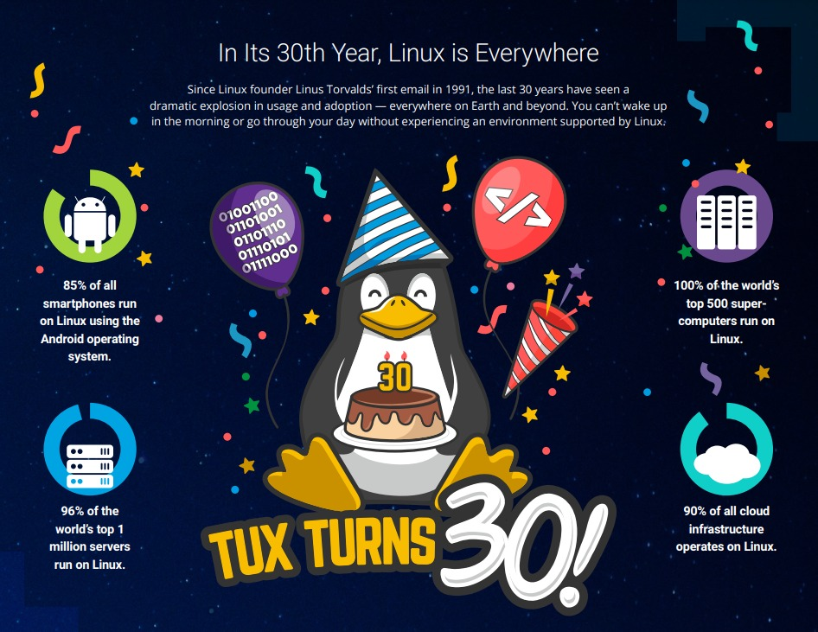
Notes:
<nomor>

Slide 43



ILC 2022 Foto Contest
Upload your ILC Activity on Instagram using hashtag:
#happy31stBirthdayLinux
#biznetgiocloud #ilc2022indonesia #MajuTerusLinuxIndonesia
Notes:
<nomor>

Slide 44

About: March of the Penguins
The movie documentary depicts the yearly journey of the emperor penguins of Antarctica.
https://en.wikipedia.org/wiki/March_of_the_Penguins
Notes:
<nomor>

Slide 45

“There are lots of Linux users who don't care how the kernel works, but only want to use it. That is a tribute to how good Linux is.”
~ Linux Torvalds
Notes:
<nomor>

Slide 46

Thank you


https://www.ilc.opensuse.id
Notes:
<nomor>

